Slide 1
JUNGLE SAFARI
GAME BY :- GARGI AGARWAL

Slide 2
Table of Contents
01
03
ABOUT MY GAME
The Solution
02
04
Big Problem
Next Steps
Basic structure of game
Playing the game , saving the animals
Endangered spices of animals
Get to know more about my idea

Slide 3
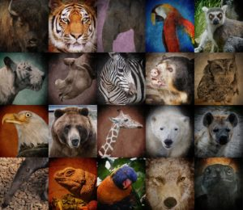
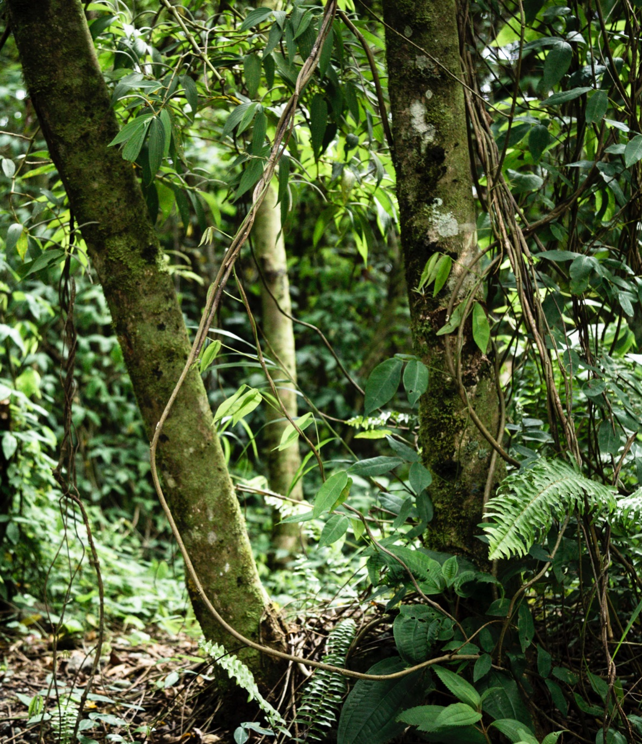



01
About my game

Slide 4

Jungle Safari
Basic things :
Simple to play
1 rupee gets donated to WWF , as you win a level
Different types of game to keep the player busy
And the most important thing: Age friendly , with variety of games .
*Funds to be arranged through NGO’s & corporates

Slide 5

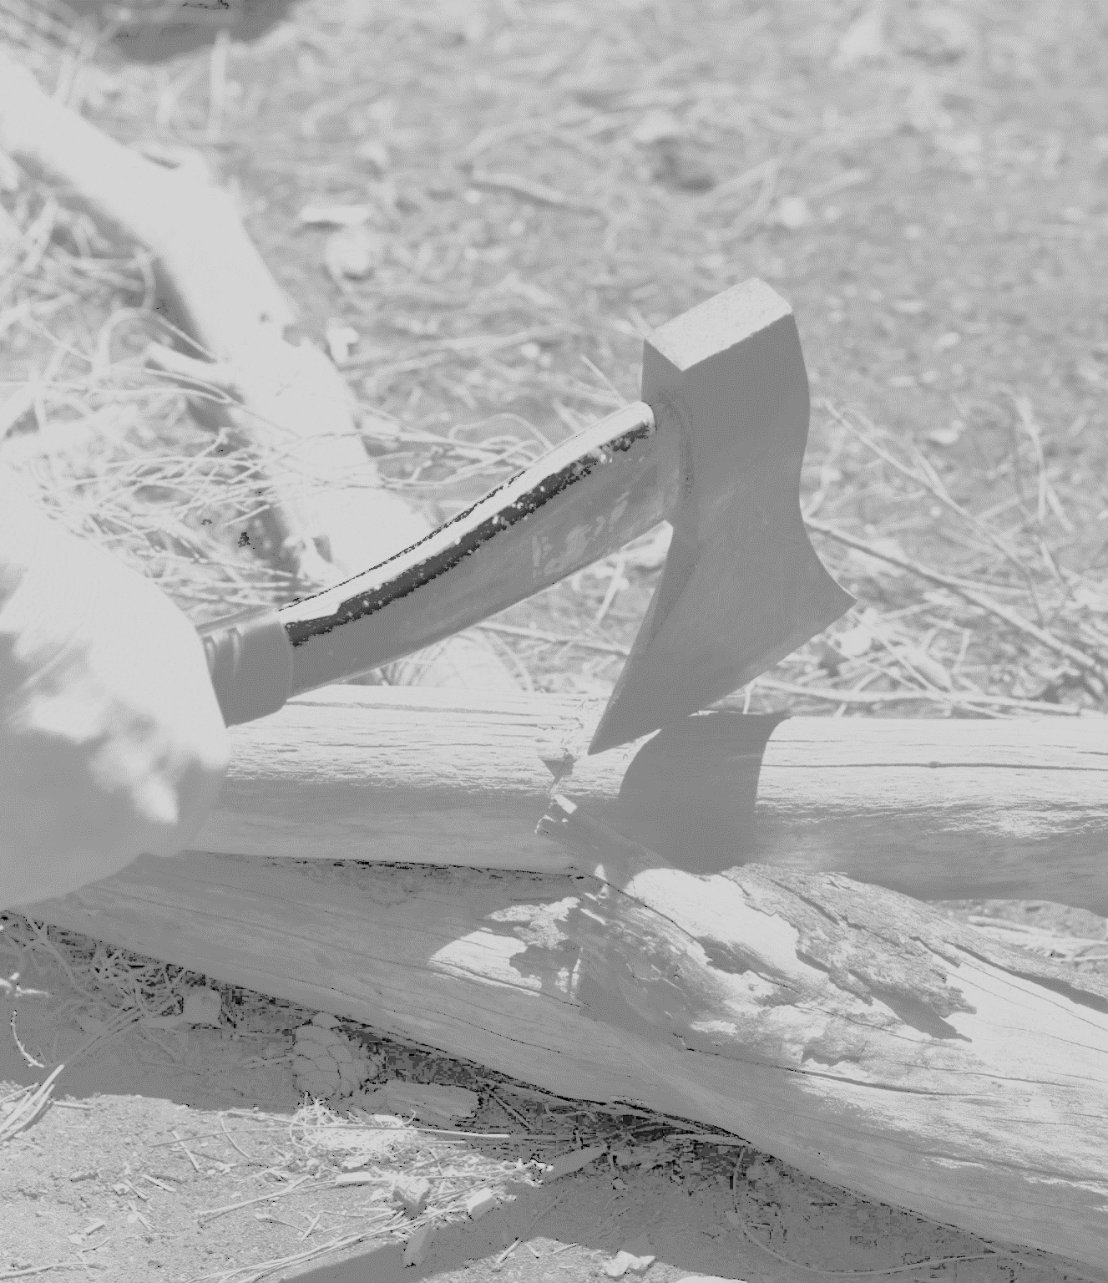







02
Big Problem

Slide 6
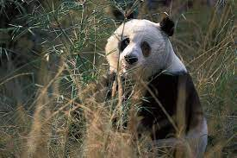
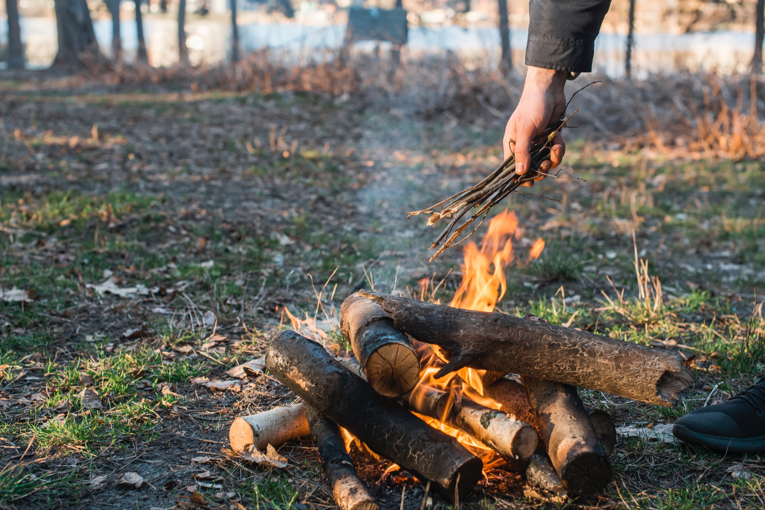
Endangered species
As we all know many species of animals, birds etc are being threatened by extinction , because of loss of habitat and loss of genetic variation . A loss of habitat can happen naturally . E.g. Dinosaurs . As well as by us humans , therefore it is our responsibility to protect them . And we can , by playing the game I have designed.

Slide 7
1,000,000
Animal and plant species are threatened

Slide 8

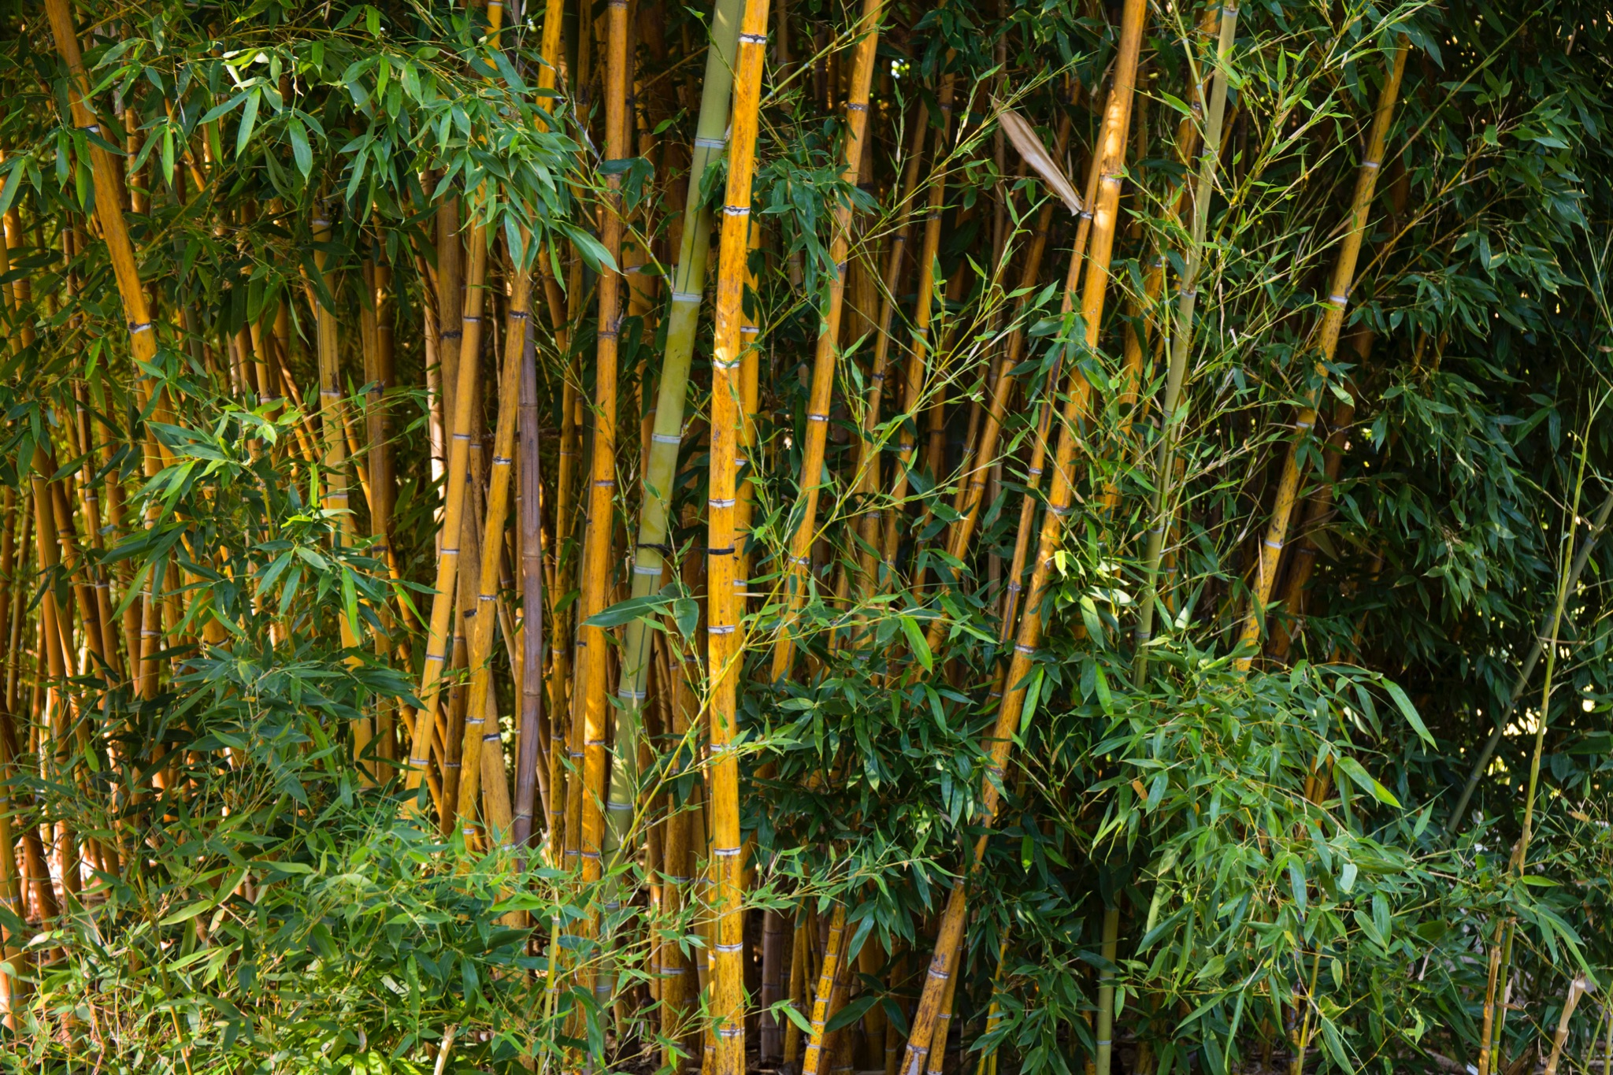

03
The Solution

Slide 9
Step By Step
As each level gets completed by the player 1 rupee will be donated to WWF
More the levels the player completes the more it benefits the species
And Slowly with the help of the dear players the rate of endangered species may reduce

Slide 10
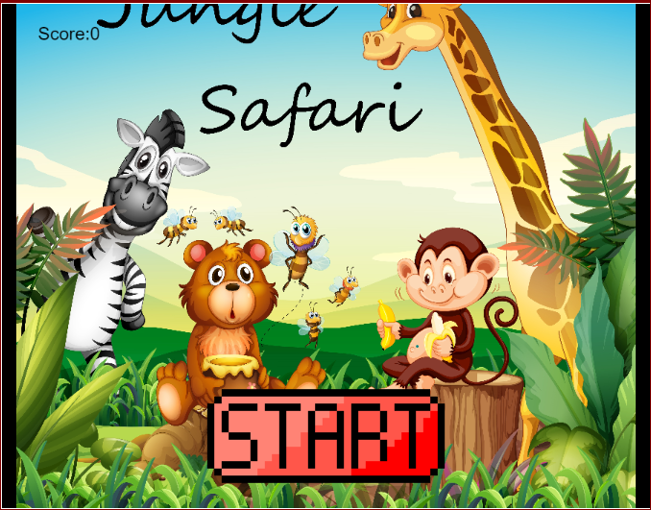

Software
Play it on desktops
On laptops
On phones
On tablets

Slide 11
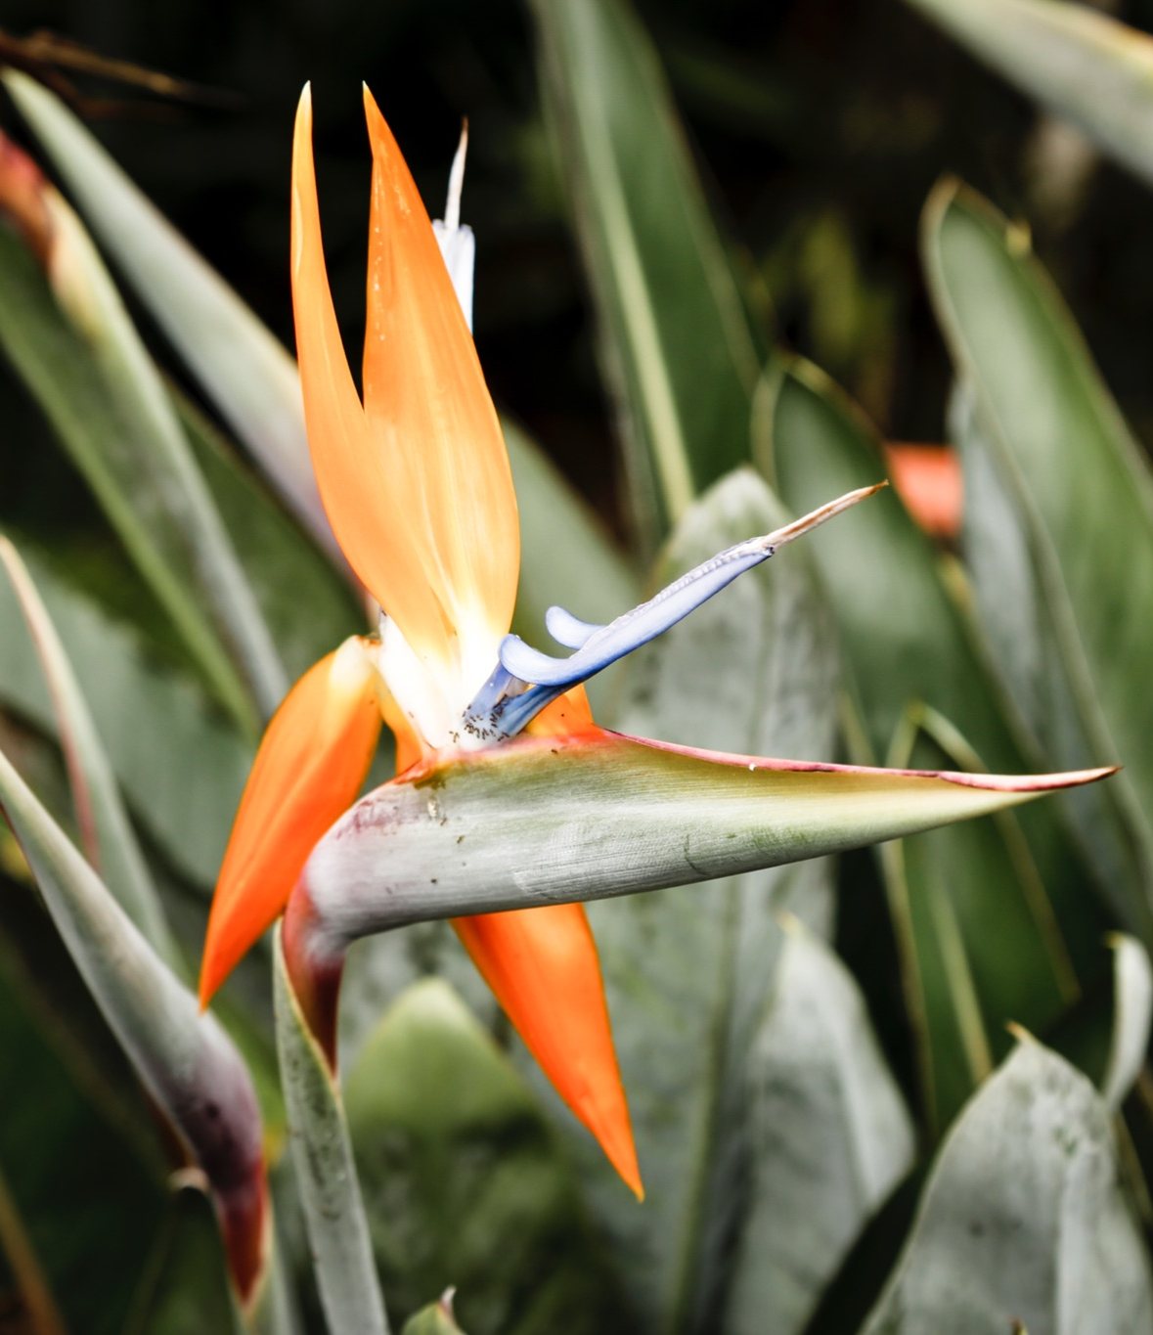

Next Steps
04

Slide 12
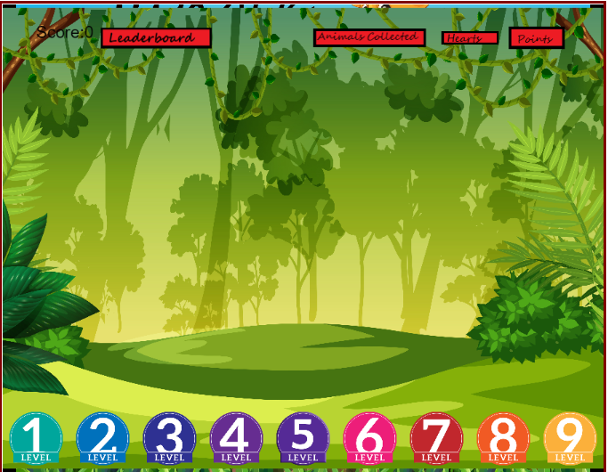
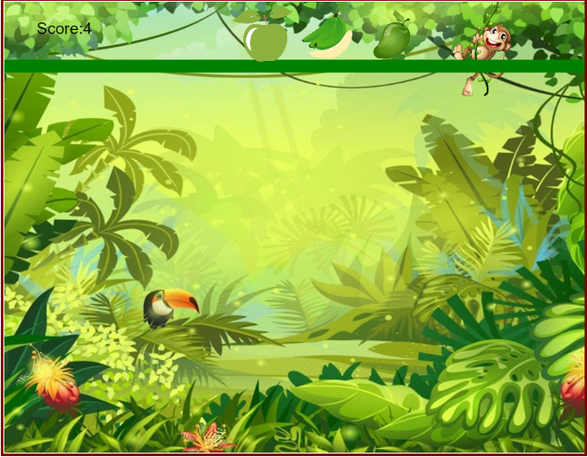
Understanding More
Basic game
Hearts
Every game has it hearts (the no. of times you can try).and some players purchase extra hearts. So the money they pay can also be donated to WWF
Needs more development
I have made one game but we can add other games .
Benefits everyone
Its benefits are endless, as the player has his choice of game to play and it also helps the animals

Slide 13
Games we can add
Cleaning a flowing river
We can make a flowing river with pollutants floating and the player taking them out by a hook
1
2
3
4
Planting your own tree
Adding a little creativety so you can plant a tree of your choice by mix-matching the seeds

Slide 14











Thanks

